Slide 1
Structural and Functional Aspects of Social Relationships and Cognition in Aging
Cassandra Brown, M.Sc.
Psychology Resident, Calgary Clinical Psychology Residency
PhD Student, University of Victoria

Slide 2
Overview
Introduction
Brief Literature Review
Research Questions
Methods
Results
Discussion
Acknowledgments

Slide 3
Introduction
Social isolation in older adulthood is gaining increasing prominence as an issue of public policy importance.
Social engagement has been suggested as a protective factor against cognitive change in older adulthood.
However, current evidence is mixed and important questions about mechanisms and the nature of any relations remain.

Slide 4
Social Relationships
Structural aspects:
Social network size
Frequency of contact with others
Functional aspects:
Provision of social support
Amelioration of loneliness
Notes:
Social relationships are complex and involve many facets that can be measured in different ways. It is not clear if different aspects of social relations are differentially related to different cognitive functions. A broad distinction is made between functional and structural aspects of social relationships that are commonly investigated. Functional aspects of social relationships include elements such as the provision of social support, while structural aspects include social network size and frequency of contact with others (Holt-Lunstad et al., 2010).

Slide 5
Literature Review
There is some evidence for the associations between a variety of social relationship factors and cognitive change in aging.
However, there are inconsistencies in the literature and no clear pattern indicating what social factors may be related to what domain of cognitive functioning.
There is little understanding of the mechanisms through which the two might be related.
Notes:
Social isolation in older adulthood is an increasingly prominent issue in light of evidence that many older adults are socially isolated which has implications for quality of life and wellbeing (2014, Report on the Social Isolation of Seniors, Chen & Freely, 2014).
Thus, there is some evidence for associations between a variety of social relationship factors and cognitive change in aging but there is no clear pattern indicating which social relationship factors are related to what aspects of cognitive functioning in older adulthood highlighting the need for further search. Identifying individual social relationship factors related to cognitive change in aging is important for several reasons, first, they have different implications for possible interventions. If objective/structural social relationship factors are important for cognitive function then intervening at this level, by providing opportunities for social contact and increased social network size may reduce the severity of cognitive decline. However, interventions that target feelings of not being supported by ones’ social network members, or feelings of loneliness may not be resolved by increasing social contact opportunities and these individuals may benefit from a more comprehensive intervention. Second, this distinction is important because the mechanistic pathways through which structural/objective social relationship measures and functional/subjective social relationship measures are related to cognitive function may differ.

Slide 6
Cognitive Performance
Time-specific fluctuations
Overall level
Baseline
Trajectory over time
Time
Notes:
From a clinical perspective we might conceptualize the time specific fluctuations as more performance based factors. A trajectory over time might represent a neurodegenerative process.

Slide 7
Social Relationships
Time-specific fluctuations
Overall level
Baseline
Trajectory over time
Time
Notes:
Social relationships may be broken down the same way but the interpretation might be different. For example, the overall level may represent a trait level of sociability. The sudden time-specific dip may be due to a change in circumstance such as moving to a new location (and always measurement error). There may or may not be a trajectory over-time. If there is it is unclear what this might represent.
Further, many studies do not examine change in both social and cognitive measures and instead use baseline measures of social factors to predict trajectories of cognitive function. When a single measurement of is taken at a particular occasion both the relatively stable individual trait (e.g., general sociability, tendency to feel loneliness), and fluctuating components that may be more related to factors unique to that particular occasion are included in each person’s score. This is true for each of social relationship factors discussed as well cognitive functioning. Distinguishing between these components is important as it is possible, and perhaps likely, that one has a relationship to cognitive performance while the other does not (Hoffman & Stawski, 2009). Further, relations between fluctuating “state-like” components have different implications from relations between relatively stable “trait-like” components. Stable “trait-like” or “level” components of social network, social contact, perceived social support, and loneliness likely reflect a myriad of factors including personality and socioeconomic status that may themselves be related to cognitive performance and risk of cognitive decline. Within the social realm it is likely a combination of an individual’s general sociability, their present circumstance (e.g., access to social contacts, marital status, etc.) are components of any single assessment. Thus, predicting later cognitive changes from a single data point at baseline means it is difficult to disentangle in what way the social relationship factor is related to cognitive function many years later.

Slide 8
Specific Questions
Do structural, specifically social network size and social contact, and functional, specifically social support and loneliness, social relationship factors show linear change over time?
Is there a relationship between levels of social relationship factors and levels of cognitive performance?
Is there a relationship between linear trajectories of social relationship factors and linear trajectories of cognitive performance?
Is there a relationship between time-specific fluctuations in social factors and time-specific fluctuations in cognitive performance?
What is the direction of the relations between social relationship factors and cognitive performance?

Slide 9
Participants - Health and Retirement Study
Participants were drawn from the 2004, 2006, 2008, 2010, 2012, and 2014 waves of the Health and Retirement Study (HRS).
The HRS is a nationally representative longitudinal panel study of individuals over the age of 50 in United States of America.
Exclusion criteria for the present analysis were ever having been diagnosed with a “memory-related disease”, Alzheimer’s disease or dementia.
Excluded occasions with participants less than 65 years old.
Notes:
Participants were drawn from the 2004, 2006, 2008, 2010, 2012, and 2014 waves of the Health and Retirement Study (HRS). The HRS is a nationally representative longitudinal panel study of individuals over the age of 50 and their spouses of any age in the United States of America. Specifically, the RAND HRS data files (RAND Center for the Study of Aging, 2008) were used as many variables have been pre-cleaned and the files are more user-friendly. The HRS is supported by the National Institute on Aging (NIA U01AG009740) and the Social Security Administration. In 2004, the HRS piloted a self-completed psychosocial questionnaire administered to a random sample of respondents (n=3,262). Beginning in 2006, the HRS began enhanced face-to-face interviews on a rotating basis of 50% of the core panel. The respondent psychosocial questionnaire was left with participants to complete and return by mail at the end of this interview, every 2 years, resulting in longitudinal data for the same participants every 4 years. In the present analysis, participants were excluded if they were younger than 65 at their first wave included assessment wave, if they did not have at least one wave of response data for all cognitive and social variables of interest, and if they reported ever having received a diagnosis of “memory-related disease”, Alzheimer’s disease, or dementia.

Slide 10
Measures
Cognitive:
Immediate Word Recall
Delayed Word Recall
Mental Status
Social:
Social network
Social support
Social contact
Loneliness

Slide 11
Analytical Strategy
Autoregressive latent trajectory models:
Allow for examination of ”state-like” and “trait-like” components simultaneously.
Allows for the investigation of cross-lagged relationships which is important in clarifying the temporal relationships between social relationship factors and cognitive performance.
Notes:
The LGM’s used in previous research cannot be used to investigate autoregressive relationships or time-specific relationships. Autoregressive latent trajectory models allow for the examination of both state-like and trait-like components simultaneously. This means that a bivariate autoregressive latent trajectory model can be used to examine relations between both components of each variable. Further, the ALT model can include cross-lagged components to allow examination of the dynamic interplay of social relationship and cognitive factors. This is an important advantage as it is unclear what the temporal relationship is between social relationship factors and cognitive performance.

Slide 12
Model Building Approach
Each social variable and cognitive variable pair were examined in separate ALT models, for a total of 12 final models.
Within each pair a progressive series of models was estimated comparing model fit to ensure increasing complexity is justified.
Autoregressive model
Latent growth model
Full ALT model
Latent growth model nested within the ALT model
ALT model with the slope (trajectory) term estimated
ALT model with slope variance constrained to zero
ALT model with autoregressive parameters constrained to equality over time.
Notes:
Based on Bollen and Curran’s (2004, 2006) recommendations models were estimated in a progressive series of i) autoregressive model, ii) latent growth model, iii) the full ALT model, iv) a latent growth model nested within the ALT model, v) the ALT model without a slope, vi) the ALT model with the slope variance constrained to 0, and vii) the ALT model with autoregressive parameters constrained to equality over time. For ALT models, the first measurement point for all processes was included in the model as predetermined.

Slide 13
Descriptive Statistics
 | Year 2004 | Year 2006 | Year 2008 | Year 2010 | Year 2012 | Year 2014
 | n = 5531 | n = 5720 | n = 5810 | n = 5698 | n = 5165 | n = 4454
 | M (SD) | M (SD) | M (SD) | M (SD) | M (SD) | M (SD)
Women (%) | 59.68 | 51.21 | 50 | 50 | 50 | 50
Age | 72.13 (5.82) | 74.07 (5.83) | 76.01 (5.85) | 78.31 (5.77) | 79.62 (5.47) | 81.15 (5.26)
Yrs Education | 12.38 (3.1) | 12.38 (3.1) | 12.38 (3.1) | 12.38 (3.1) | 12.38 (3.1) | 12.38 (3.1)
Health Conditions | 1.96 (1.19) | 2.13 (1.22) | 2.28 (1.23) | 2.47 (1.25) | 2.53 (1.26) | 2.58 (1.26)
Mental Status | 8.53 (0.79) | 8.51 (0.81) | 8.44 (0.88) | 8.07 (1.1) | 8.09 (1.16) | 7.97 (1.32)
Word Recall Immediate | 5.45 (1.5) | 5.31 (1.53) | 5.18 (1.54) | 4.86 (1.64) | 4.74 (1.63) | 4.63 (1.65)
Word Recall Delayed | 4.4 (1.84) | 4.23 (1.89) | 4.12 (1.88) | 3.75 (1.95) | 3.61 (1.97) | 3.49 (1.96)
 | n = 1061 | n = 2787 | n = 2737 | n = 2646 | n = 2235 | n = 2031
Loneliness | 1.35 (0.47) | 1.43 (0.51) | 1.44 (0.51) | 1.43 (0.51) | 1.46 (0.5) | 1.43 (0.51)
Social contact | 30.56 (8.37) | 29.6 (8.14) | 29.61 (8.6) | 29.41 (8.49) | 28.99 (8.78) | 28.65 (8.75)
Social support | 9.81 (1.53) | 9.58 (1.52) | 9.56 (1.6) | 9.58 (1.56) | 9.61 (1.59) | 9.58 (1.61)
Depression | 1.16 (1.72) | 1.23 (1.75) | 1.23 (1.73) | 1.3 (1.78) | 1.34 (1.82) | 1.38 (1.86)
Social network | 3.44 (0.76) | 3.41 (0.72) | 3.31 (0.77) | 3.25 (0.79) | 3.12 (0.84) | 3.04 (0.86)

Slide 14
Results: Social Factors
Models did not converge when trajectory terms were included for social variables.
Social Network
Previous social network predicted social network two years later.
Social Contact
Social contact significantly predicted social contact two years later.
Social Support
Earlier social support significantly predicted later social support. (consistently over time)
Loneliness
Earlier loneliness significantly predicted later loneliness (consistently over time).
Notes:
Social Network: In univariate models the full ALT was a significantly better fit. Social network size significantly declined over time with significant variance. Autoregressive parameters were also significant.
Social Support: In the univariate models autoregressive parameters were constrained. The ALT model was supported. Social support did not show a mean trend over time but the variance was significant. Previous social support significantly predicted later social support over and above the trajectory of social support.
Social contact increased over time, the variance in slope was not significant.
Loneliness: In the univariate models the ALT with only level of slope estimated was supported by model fit indices. Previous loneliness significantly predicted later loneliness.

Slide 15
Results – Cognitive Performance
Immediate Word Recall
Immediate recall performance decreased on average over time with significant variance.
Previous immediate word recall performance did not predict immediate word recall performance two years later, after accounting for trajectory.
Delayed Word Recall
On average delayed word recall performance decreased over time, with significant variance.
Previous delayed word recall performance did not predict performance two years later.
Notes:
Women and those with more years of education had significantly higher initial immediate word recall scores and significantly higher immediate word recall scores overall, across all occasions. Those who were older and had more health conditions had lower initial immediate word recall scores and lower immediate word recall scores overall, across all occasions.

Slide 16
Results: Cognitive Performance Continued
Mental Status
Overall, mental status decreased over time, with significant variance.
Earlier mental status significantly predicted later mental status over and above the overall trajectory of change.

Slide 17
Results: Bivariate Relations

Slide 18
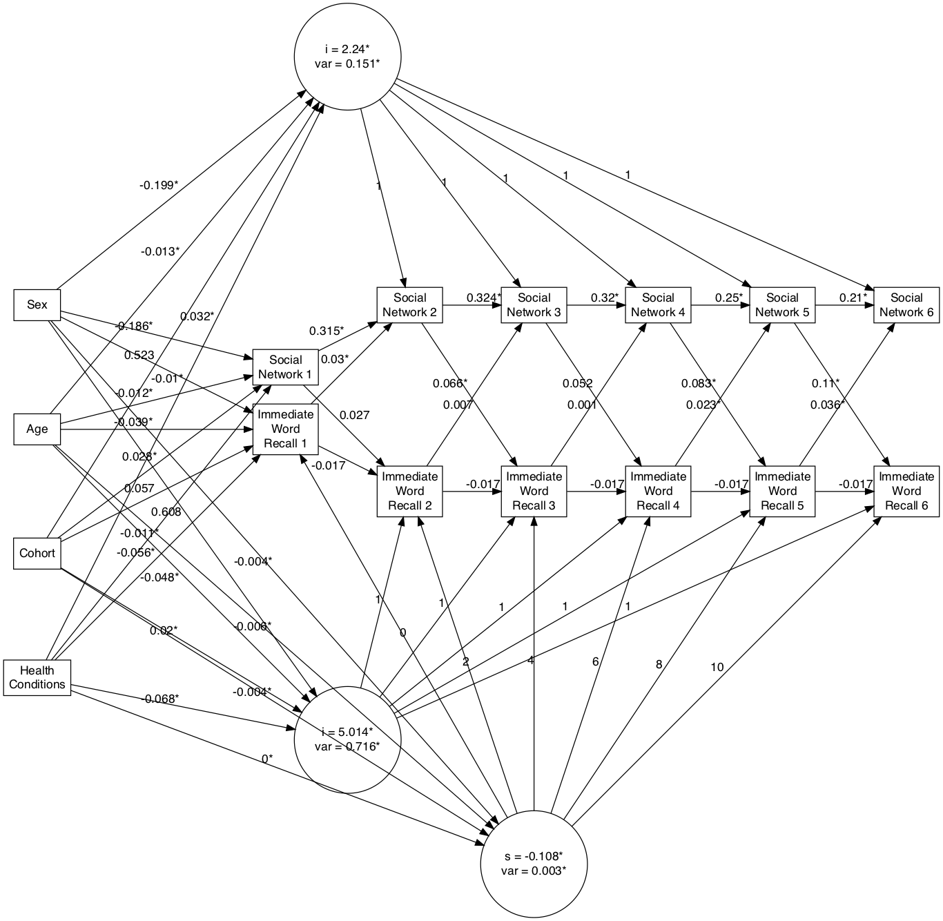
Immediate Word Recall & Social Network
Notes:
Immediate word recall performance is predictive of social network size two years later at time 4 and 5.
Social network predicted immediate word recall performance two years later at time 1 and time 4 and time 5.
There was no relationship between intercept terms.
Intercept of social network did not predict change in immediate word recall over time.
There was no relationship between immediate word recall level and rate of decline either although those with higher initial immediate word recall performance had lower rates of decline over time.

Slide 19

Delayed Word Recall & Social Network
Notes:
Intercepts not related. The intercept of social network did not predict the slope of immediate word recall.
Social network predicted delayed word recall performance at time 5 only.
Delayed word recall predicted social network at time 1, time 4, and time 5.

Slide 20

Mental Status & Social Network
Notes:
Intercept terms not related. First occasion not related. Social network intercept and first occasion did not predict social network slope.
Social network significantly predicted mental status two years later at all except the first occasion.
Mental Status predicted social network for the all occasions.

Slide 21
Social Network Results Summary
Overall level of social network was not related to level or change in any of the cognitive measures examined.
Mixed evidence for relations between time-specific components of social network and both immediate and delayed recall.
Consistent cross-lagged relationship between social network time-specific fluctuations and mental status time-specific fluctuations.

Slide 22

Immediate Word Recall & Social Contact
Notes:
There was a significant relationship between immediate word recall performance intercept and social contact intercept. The first occasions of these were also related. Intercept of social contact did not predict slope of immediate word recall.
Social contact did not predict immediate word recall performance two years later at any occasion.
Beginning at the third wave immediate word recall did predict social contact two years later.

Slide 23

Delayed Word Recall & Social Contact
Notes:
The intercepts of social contact and delayed word recall were positively related.
The first occasions of measurement were not.
The intercept of social contact did not predict the slope of delayed word recall.
Social contact did not predict delayed word recall performance two years later at any occasion.
Delayed word recall performance did significantly predict social contact two years later at time 3, time 4, and time 5.

Slide 24
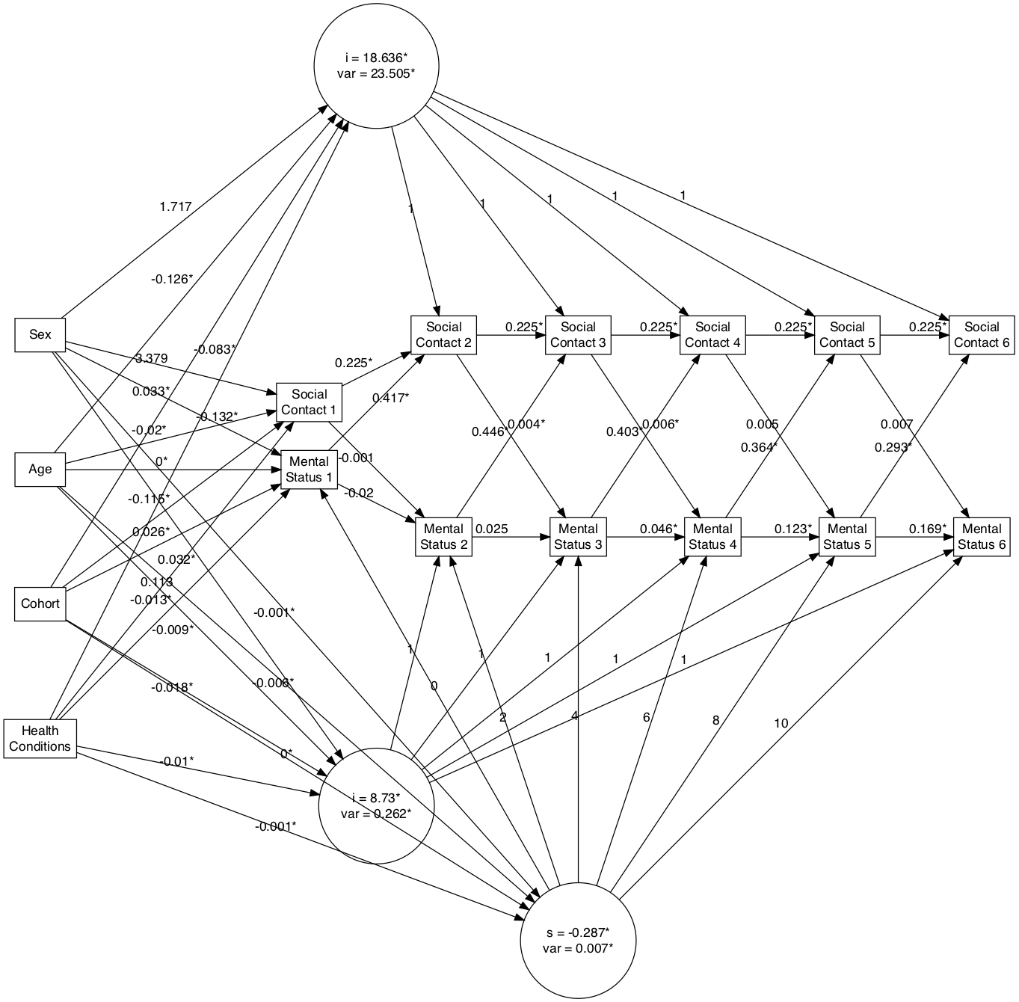
Mental Status & Social Contact
Notes:
No significant relations between intercepts or first occasion. Social contact intercept does not predict change in mental status.
Social contact predicted mental status at time 2 and time 3.
Mental status predicted social contact at all occasions.

Slide 25
Social Contact Results Summary
Overall level of social contact was related to overall immediate and delayed recall performance.
Time-specific increases in immediate and delayed recall performance predicted time-specific increases in social contact two years later beginning at time 3.
Time-specific increases in social contact were not predictive of time-specific increases in immediate or delayed recall.
Time-specific increases in mental status predicted time-specific increases in social contact two years later at all occasions. The reverse was true only at time 2 and 3.

Slide 26

Immediate Word Recall & Social Support
Notes:
Intercepts not related. First measurement not related. Social support intercept not related to immediate word recall slope.
No cross-lagged relationship significant.

Slide 27

Delayed Word Recall & Social Support
Notes:
No relationship between intercepts. No relationship between first occasion of measurement.
Intercept of social support did not predict delayed word recall slope.
Only social support at time significantly predicted delayed word recall performance two years later.
Delayed word recall performance did not predict social support two years later at any occasion.

Slide 28

Mental Status & Social Support
Notes:
No significant correlations between intercept terms or first occasion measurement.
Social support did not predict change in mental status.
Only social support at time two positively predicted mental status.
Mental status did not predict social support at any occasion.

Slide 29
Social Support Results Summary
Little evidence for relations between social support and cognitive performance.

Slide 30

Immediate Word Recall - Loneliness
Notes:
No correlation between intercept factors or first measurement occasions. Loneliness did not predict trajectory of immediate word recall.
Loneliness significantly predicted mental status from time 3 onwards.
Immediate word recall significantly predicted loneliness at every occasion.

Slide 31

Delayed Word Recall - Loneliness
Notes:
No significant relation between intercepts or first occasion of measurement.
Intercept of loneliness was not related to change in delayed word recall over time.
Loneliness at time 1 and loneliness at time 3 predicted delayed word recall performance two years later.
Delayed word recall performance predicted lonliness at time 1 and time 2.

Slide 32

Mental Status - Loneliness
Notes:
Intercepts and first measurement occasions not related
Loneliness did not predict change in mental status.
Loneliness at time 3 significantly predicted mental status at time 4.
Mental status predicted loneliness at all occasions.

Slide 33
Loneliness Results Summary
No relations between overall levels of loneliness and overall cognitive performance.
Time-specific increases in immediate word recall and mental status consistently predicted time-specific decreases in loneliness two years later.
Less consistent evidence for time-specific changes in loneliness predicting time-specific fluctuations in cognitive performance.

Slide 34
Summary
Overall, there were few relations between overall levels of social factors and level and change in cognitive performance measures.
There was no clear differentiation between structural and functional components in their relations to cognitive performance.
Changes in cognitive performance may be the leading indicator of changes in social relationship factors.

Slide 35
Discussion
Cognitive changes in older adulthood may put individuals at risk of decreased social network diversity, decreased social contacts and increased loneliness.
These relations may be reciprocal further increasing risk of poorer cognitive performance.
The quality of existing social relationships appears unrelated to cognitive performance.

Slide 36
Acknowledgements
Andrea Piccinin, PhD
Andrey Koval, PhD

